Slide 1

Caching on IndiaMART
Shranik Jain & Mahendra Prasad
7/05/2019

Slide 2

Overview
What & Why caching?
Types of Caching
Caching Implementation on IndiaMART
Challenges & Solutions
Architecture & Condition’s on Dir.IM & WWW
Impact of Caching
Roadmap Ahead
7

Slide 3

What is Caching?
What did you have for breakfast?
7
Notes:
You may remember or you may not — maybe you didn’t even have breakfast today! The point is, just like how you can recall what you’ve encountered previously, computers can recall what they encountered in the past.
I personally spend a lot of my time on the Internet, and I visit certain websites everyday. For example, I visit Facebook a lot when I am bored, and I go to Google when I need an answer to a question. These two websites load almost instantly, and others seem to load somewhat more slowly. The browser behaves this way due to “cacheing”.

Slide 4

Caching Overview
7

Slide 5



Why Caching?
Big wins from low-hanging fruit
With great scale comes great responsibility
Decreased Crawl Time
Less Server Errors
Happy Database
7
Notes:
Caching is extremely important because you can get dramatic performance improvements without a lot of effort in certain situations
Big wins from low-hanging fruit
Imagine you’re IMDB and you have a lot of data that doesn’t really change, like movie metadata (think summary, actor information, location details). That data is probably stored somewhere — perhaps a SQL database. When a user visits the web page for a particular movie, they are presented with all this information that is essentially static.
Because you don’t expect the basic metadata to change, it’s wasteful to go look it up in the database on every single page visit. It would be far more performant to look it up in a cache (local to the web server) than fetch it from the SQL database, which is remote from the web server—at a minimum, another network hop. This also creates a lot of extra unnecessary load on the database.
With great scale comes great responsibility
Woah, it’s getting 10,000 page views every second. Your SQL database is getting hammered.
In a desperate attempt to keep the entire website from keeling over, you add a cache to the web server ,Whenever a page tries to look up the metadata, it gets the data directly from the cache, which is a process running locally on the web server that returns the data in a few milliseconds at most. Not only have you dramatically cut down the response time, saving a network hop and a slow CPU on your database, you’ve also significantly cut down the load on that poor, overworked database, saving other features in your application from failing.

Slide 6



Types of Caching
Forward Proxy Cache
Reverse Proxy Cache
Server Cache
Client-Side Cache
7
Notes:
Every browser ships with an implementation of an HTTP cache (a.k.a. web cache) for the temporary storage of web documents such as HTML pages, javascript files, and images.
This is a very powerful feature because it has several benefits:
The user experience is improved because resources are loaded quickly from the local cache. There is no round-trip-time (RTT) as requests are not sent over the wire
It reduces the load on the application server and other components in the pipeline
Everyone saves on paying for unnecessary bandwidth and it frees that bandwidth for other users on the internet

Slide 7


Caching on IndiaMART
Dir.IM
Product-Detail
FCP
Mobile Site
Varnish Cache
7

Slide 8



Challenges & Solutions
There are only two hard things in Computer Science: cache invalidation and naming things.
-- Phil Karlton
Dir.IM
200 OK
Product Detail
FCP
7

Slide 9
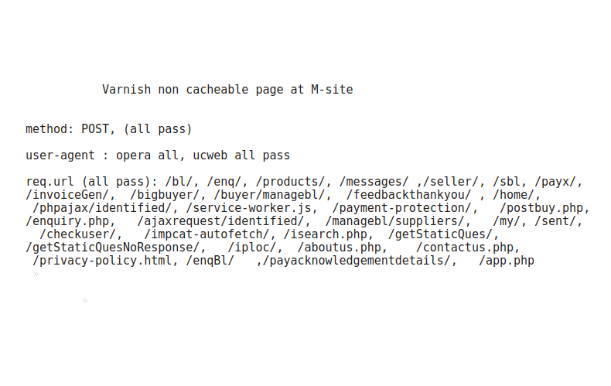
Challenges & Solutions
7

Slide 10







Architecture & Condition’s
on Dir.IM & Mobile-IM
User
Varnish
Server
1 hr.
1hr. -72hrs.
>72 hrs
7

Slide 11
Architecture & Condition’s
On Home-Server
User
Varnish
Server
24hrs.
24hr. -1month
>1 month
7

Slide 12



Challenges & Solutions
Dynamic Data
User
Varnish
Server
7

Slide 13
Challenges & Solutions
5xx Handling
User
5XX
3 Days old Cache(User Region)
Cache with any age(any Region)
5xx
Cache with any age(User Region)
7

Slide 14
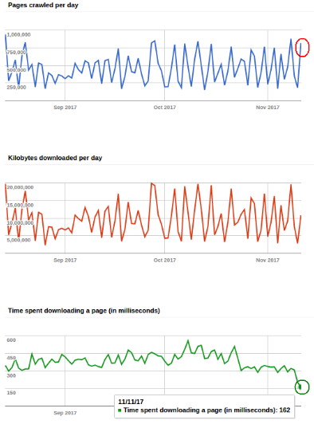

Impact of Varnish Cache
57% Decrease in Crawl Time
14% Increase in Pages Crawled
425ms Normal Req. Response Time
1ms Cached Req. Response Time
7

Slide 15


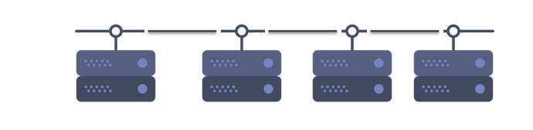
DIR Varnish Setup
Users
Global Load Balancer
Varnish US-Central Server
Varnish India Server
DIR-Instance-US Central
2 Server for IMPCAT & 2 for Search
Search
IMPCAT
API
US-Central
7

Slide 16


Mobile Varnish Setup
Users
DNS
Country-Europe Only
Elastic Load Balancer
Global Load Balancers
Varnish AWS
(US)
Varnish Server
(India)
Varnish Server
(US)
6 AWS Mobile Instances in Virginia
6 GCP Mobile Instances in US Central

Slide 17

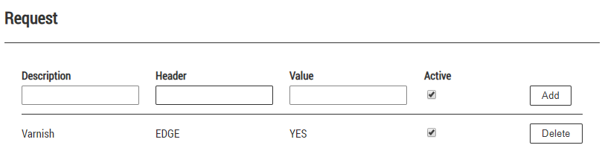
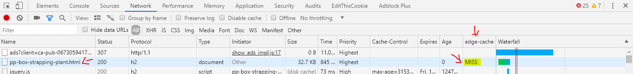
How to Test Varnish?
Step 1 : Download “Header-Editor” Chrome Extension
Step 2 : Make Following Entry in “Request Field”
Step 3: Add “edge-cache” request header in Google Chrome Developer Console, Always open
New tab to test the varnish
7

Slide 18
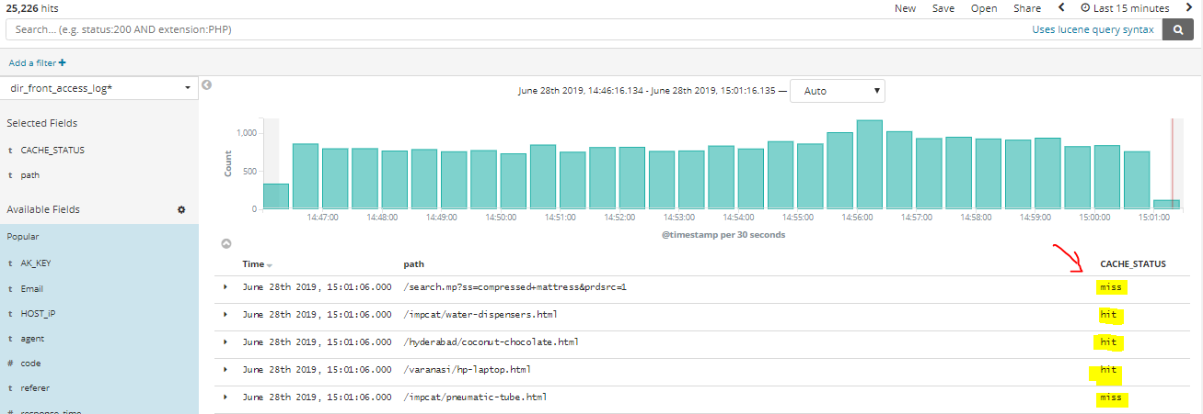
How to Test Varnish?
7

Slide 19
Roadmap Ahead
Varnish Cache Creation for multilingual pages
Disaster Recovery in case of GCP downtime on Desktop
7

Slide 20
Thank you

